Slide 1
Text processing and classification (nlp)
DONE BY:
D.CHARAN (192211577)
B.DHANUSH (192211762)
SHAIK.ANWAR (192211801)

Slide 2
Abstract:
In this informative age, many documents in different Indian languages are available in digital forms.
For the easy retrieval of these digitalized documents, these documents must be classified into a class according to its content.
Text classification is an area of text mining which helps to overcome this challenge.
Text classification is act of assigning classes to documents.
Text being present in Indian language imposes the challenges of natural language processing.

Slide 3
INTRODUCTION:
With the advent of world wide web, amount of data on web increased tremendously.
Text classification the act of dividing a set of input documents into two or more classes where each document can be set to belong to one or multiple classes.
Text classification is the text mining technique which is used to classify the text documents into predefined classes.
Text classification is combination of text mining as well as Natural language processing.

Slide 4
Problem definition and algorithm:
Text classification is a machine learning technique that assigns a set of predefined categories to open-ended text.
TEXT PROCESSING:
.Tokenization:
Definition: Breaking down a text into smaller units, such as words or phrases.
Libraries: NLTK (Natural Language Toolkit), spaCy
TEXT CLASSIFICATION:
Naive Bayes:
Algorithm Type: Probabilistic.
Pros: Simple, efficient, works well with small datasets.
Cons: Assumes independence of features.

Slide 5
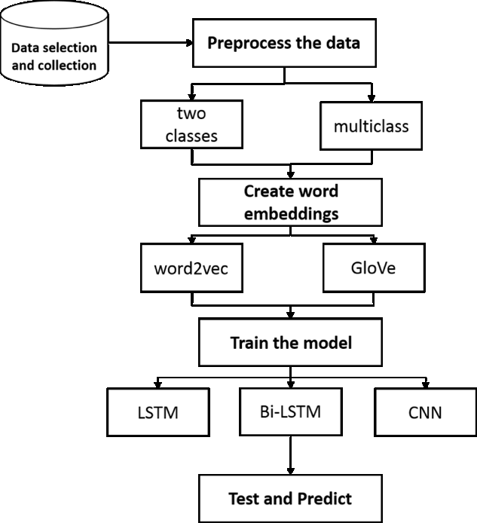
METHODLOGY:

Slide 6
RESULT and conclusion:
Text classifiers can be used to organize, structure, and categorize pretty much any kind of text – from documents, medical studies and files, and all over the web.
And it is easy to recognize the documents.
It has scalability, speed of analysis, consistency, and the ability to make quick decisions based on real-time conversations.

Slide 7
THANK YOU

